Slide 1
Threat Hunting Station
Log4j: The Silent Menace Among Us

Slide 2
Outline
Log4j: Anatomy
Art of Querying
Data Sources: Where and What to Look
Interpreting Results
Real-World Example: A Walkthrough of Threat Hunting for Log4j

Slide 3

Log4j: Anatomy
log4j is a popular logging package for Java
Other logging packages like SLF4J/Logback
"Lookups provide a way to add values to the Log4j configuration at arbitrary places"

Slide 4
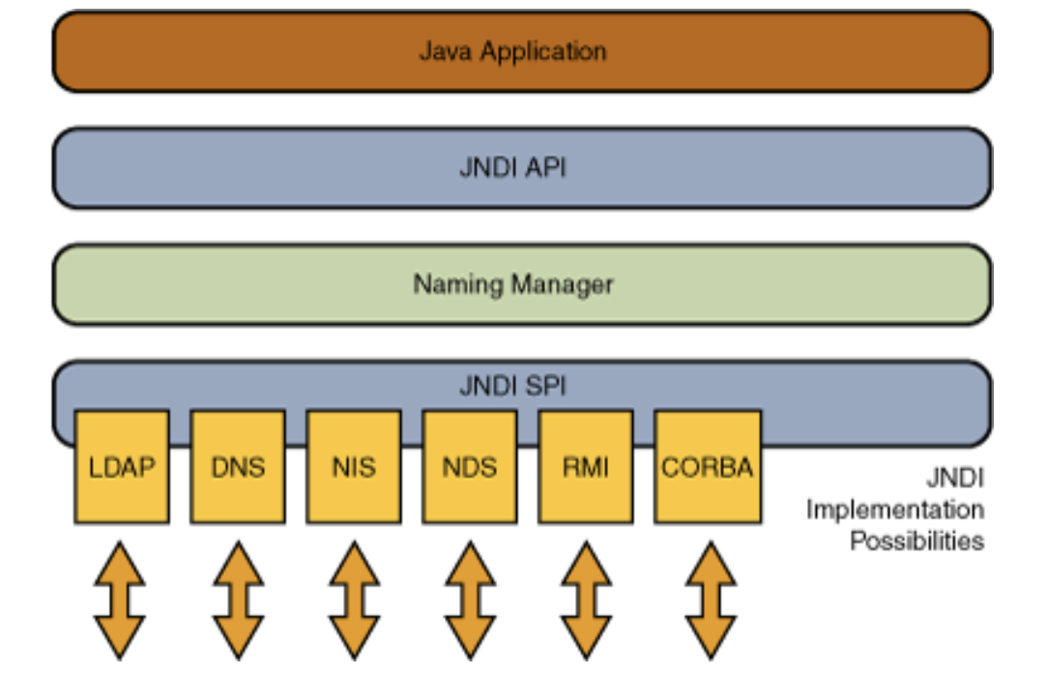
JNDI
"The JNDI API is a generic API for accessing any naming or directory service"
Remote Method Invocation (RMI), Common Object Request Broker Architecture (CORBA), Lightweight Directory Access Protocol (LDAP), or Domain Name Service (DNS) and many more supported
Nothing new to Vulnerabilities Click-to-play bypass Deserialization attack TopLink/EclipseLink

Slide 5
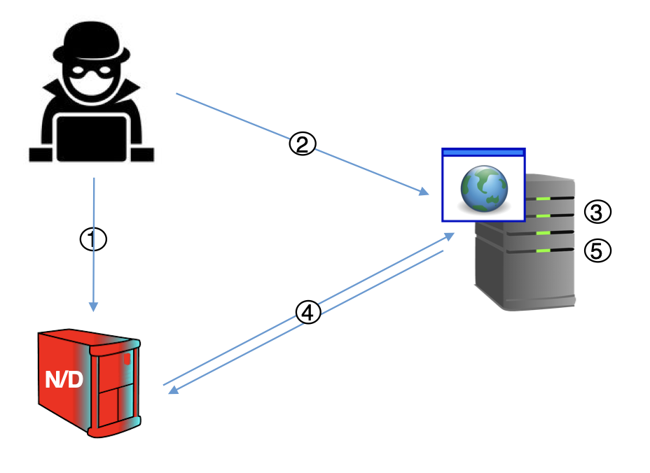
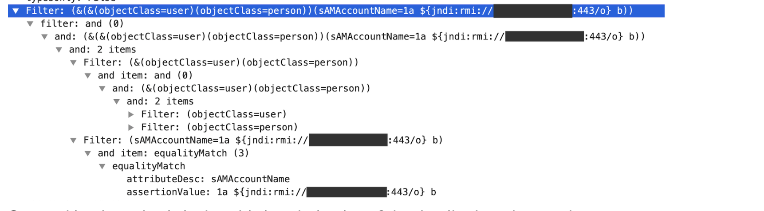
Attack Scenario
1. Attacker creates a malicious LDAP server to deliver payload
2. Attacker sends request to vulnerable application
3. The request contains a special message that has JNDI lookup for unknown JAVA object
4. request is logged using log4 which performs JNDI request to the attacker infra using LDAP
5. Application downloads the malicious payload, decodes it and triggers it

Slide 6
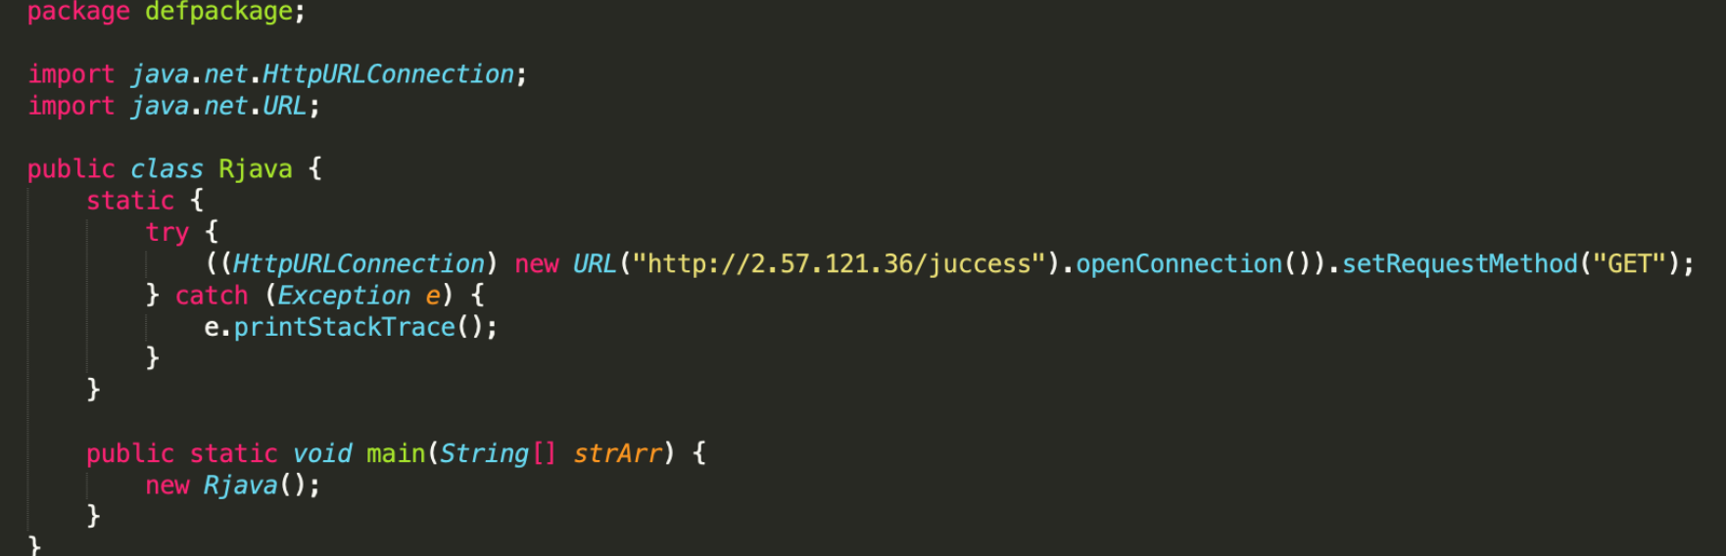
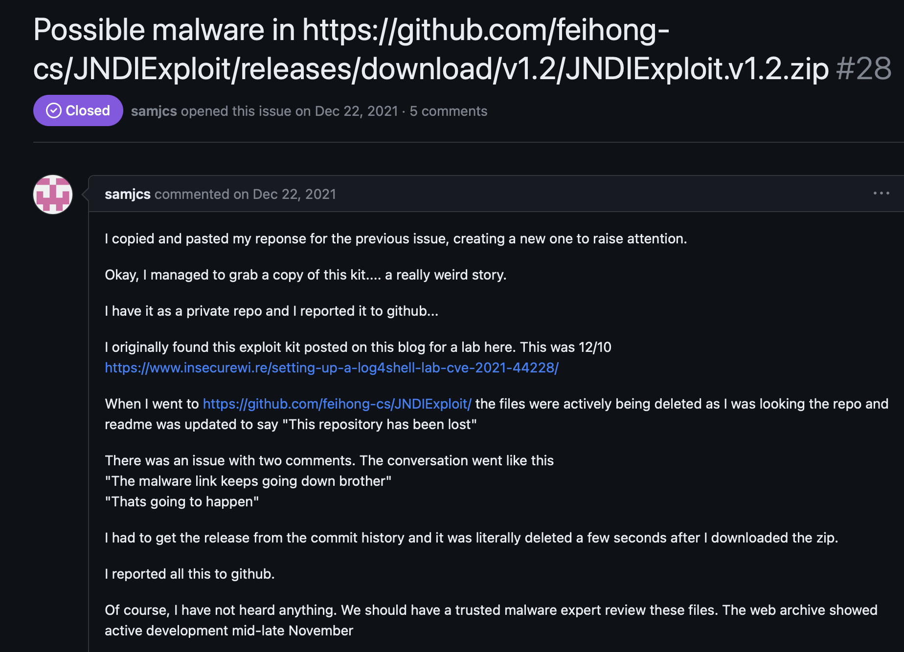
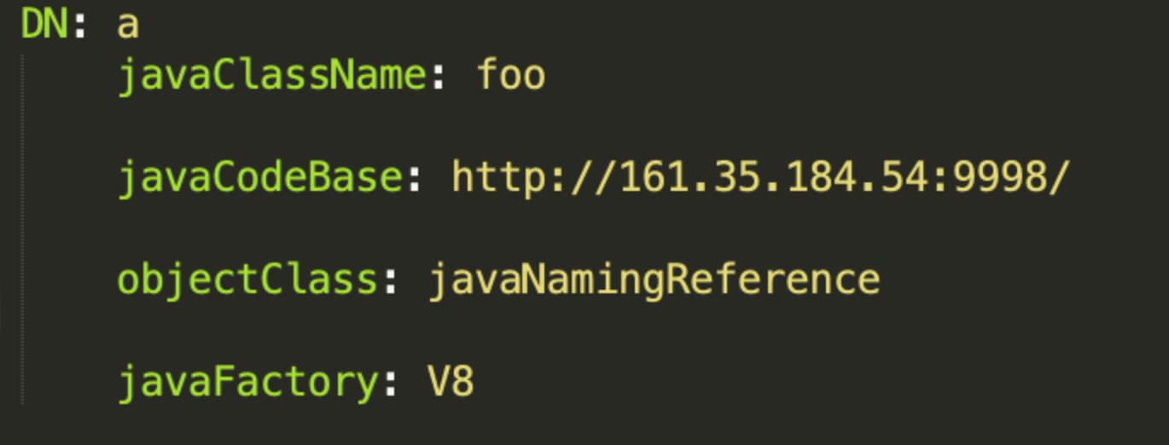
Attack Scenario

Slide 7
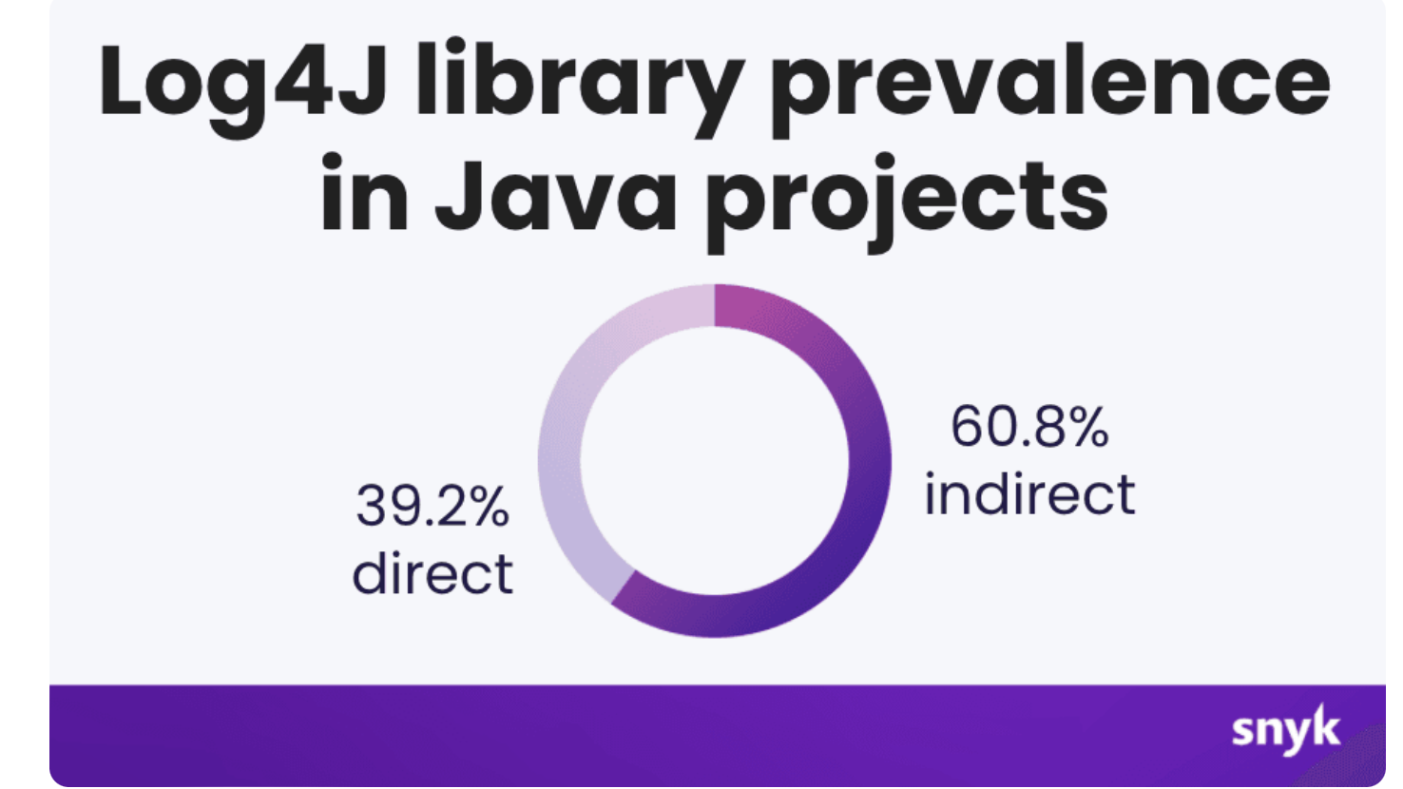
Working with TI
MuddyWater, MERCURY/Mango Sandstorm , XMRig
interested in gain access in our environment using Log4j

Slide 8
Mitigations and preventions
“In releases >=2.10, this behavior can be mitigated by setting either the system property log4j2.formatMsgNoLookups or the environment variable LOG4J_FORMAT_MSG_NO_LOOKUPS to true. For releases from 2.0-beta9 to 2.10.0, the mitigation is to remove the JndiLookup class from the classpath: zip -q -d log4j-core-*.jar org/apache/logging/log4j/core/lookup/JndiLookup.class.”
Does not protect against ContextMap with "${ctx:...}”
log4j-jndi-be-gone by nccgroup

Slide 9
The Art of Querying: Techniques for Effective Threat Hunting
extracting useful information
rustrating process
Challenges like non-existent, ambiguies, vague etc

Slide 10
How?
clear understanding
specific ideas or items
understanding of the query language

Slide 11
Types of Queries
1. Simple query
searching for simple string like ghostc2
2. compound query
Checking for netflow traffic and cross correlating with DNS query and proxy logs.
3. statistical query
Check prevalence of process for all users, then checking prevalence of the process by counting the combination of process and users.

Slide 12

Know your environment and data
What technologies are present for security monitoring?
What data is generated?
What are our assets?
Known-normal?

Slide 13

Data tricks you
1. ${${::-j}${::-n}${::-d}${::-i}:${::-l}${::-d}${::-a}${::-p}://
${${::-j}${::-n}${::-d}${::-i}:${::-r}${::-m}${::-i}
2. ${${lower:j}${upper:n}${lower:d}${upper:i}:${lower:l}d${lower:a}p://
${${lower:j}${upper:n}${lower:d}${upper:i}:${lower:r}m${lower:i}://
Variation
Obfuscation
Common Information Model
Attacker Trickery

Slide 14
Hunt for similar Vulnerabilities
Threat-intel based hunting allows you to step into several roles
Hunt for deserialization vulnerabilities with heyserial, yoserial, marshelsec
Check “Hunt for exposed devices” by Microsoft for generic inventor and vulnerabilities
Searching for post-exploitation activities
Combining common activities gathered from different exploitation for patterns in post-exploitation
Collaboration with vulnerability, Risk and Application management teams

Slide 15

A Lab Walkthrough of Threat Hunting Against Log4j Vulnerability

Slide 16
Threat Hunting Template
Title: Hunting for Prisma Logs
Date Created:
Hypothesis: Attackers are exploiting a zero-day vulnerability in log4j library to perform remote execution on applications for gaining access to our environment
MITRE Tactic: Initial Access
MITRE Sub Technique: Exploit Public-Facing Application
Simulation Details (if any): Does not apply to us
Proposed Search Query:
Hunter Limitations Notes: The Consistency of our data is not helping us to perform advanced queries leading to perform regex searches
Hunt Findings:

Slide 17
References
https://www.innoq.com/en/articles/2022/04/java-jndi/
https://research.nccgroup.com/2021/12/12/log4shell-reconnaissance-and-post-exploitation-network-detection/
https://unit42.paloaltonetworks.com/apache-log4j-vulnerability-cve-2021-44228/
https://github.com/christophetd/log4shell-vulnerable-app/issues/28
https://twelvesec.com/2022/01/21/log4shell-exploiting-a-critical-remote-code-execution-vulnerability-in-apache-log4j-cve-2021-44228/
https://gist.github.com/gsasikumar/b7d68aea13bd0304a3e1c70151a8d963
https://www.veracode.com/blog/research/exploiting-jndi-injections-java
https://www.blackhat.com/docs/us-16/materials/us-16-Munoz-A-Journey-From-JNDI-LDAP-Manipulation-To-RCE.pdf
https://github.com/carlospolop/hacktricks/blob/master/pentesting-web/deserialization/jndi-java-naming-and-directory-interface-and-log4shell.md#rce---jndiexploit

